Slide 1
Java Object Oriented
Università di Modena e Reggio Emilia
Prof. Nicola Bicocchi (nicola.bicocchi@unimore.it)

Slide 2
Classes and Objects

Slide 3

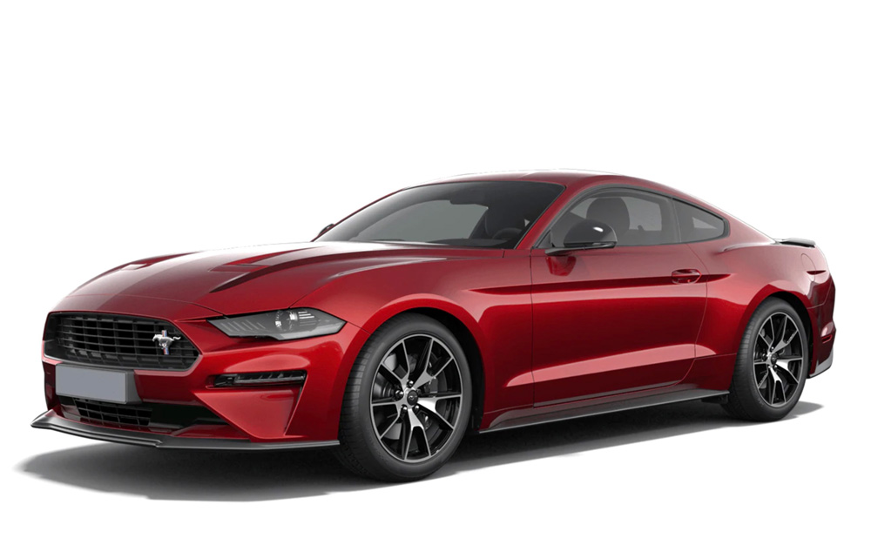
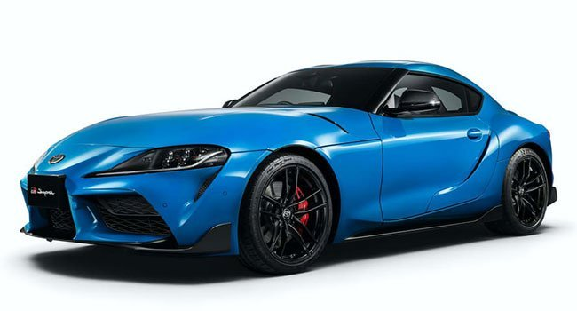

Classes and objects
public class Car {
boolean isOn;
String brand;
String color;
public Car(boolean isOn, String brand, String color) {
this.isOn = isOn;
this.brand = brand;
this.color = color;
}
/* ... */
}
Car c1 = new Car(false, Ford, Red);
Car c2 = new Car(false, Toyota, Blue);
Car c3 = new Car(false, Tesla, White);

Slide 4
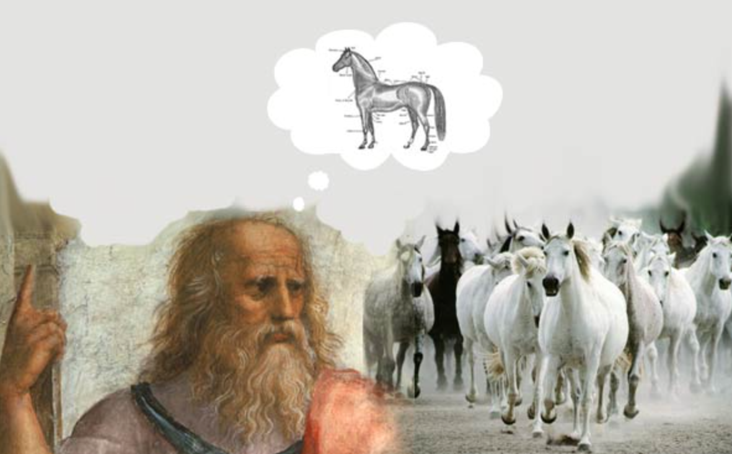
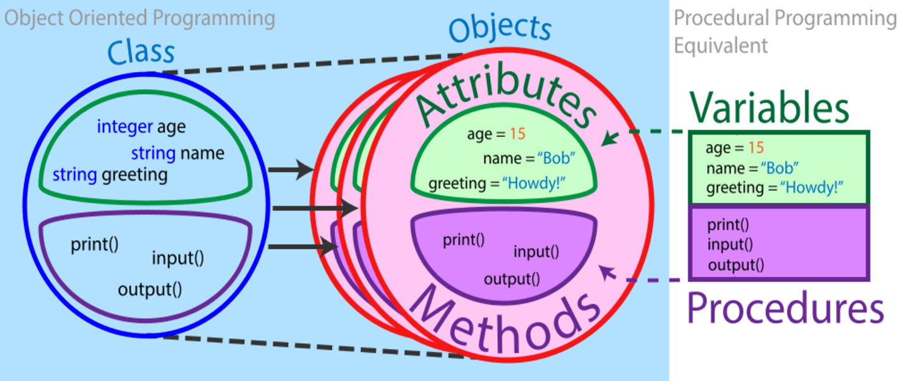
Class

Slide 5
Classes and objects
Class (the description of objects’ structure):
Data (VARIABLES, ATTRIBUTES)
Code (OPERATIONS, METHODS)
Object (class instance)
Identity
Type
Internal state
One or more references must point to every valid object
A class is like a type definition. No data is allocated until an object is created from the class
The creation of an object is called instantiation. The created object is called an instance
No limit to the number of objects that can be created from a class
Each object is independent. Changing one object doesn't change the others

Slide 6
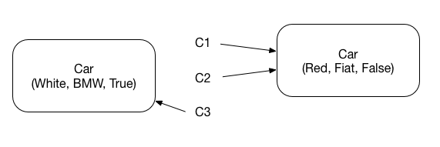
Object creation
Creation of an object is made with the keyword new which creates a new instance of the specified class, and allocates it in memory (heap)
new calls the constructor method of the class (a method without return type and with the same name of the Class)
new returns a reference to the portion of memory containing the created object
Car c1 = new Car(Red, Fiat, False);
Car c2 = c1;
Car c3 = new Car(White, BMW, True)

Slide 7
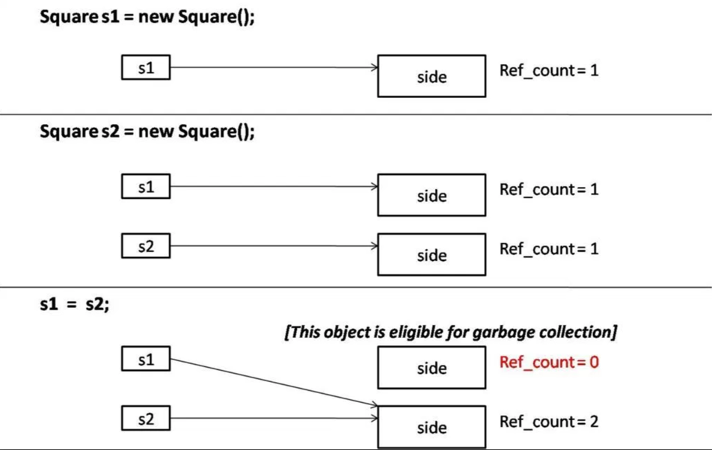
Object destruction
It is no longer a programmer concern. Java supports Automatic Garbage Collection (an automatic way for de-allocating unreferenced objects)

Slide 8
Operations on references
Only the relational operators == and != are defined:
The equality condition tell you whether two references points to the same object in memory
The equality condition is evaluated on the values of the references and NOT on the values of the objects !
There is NO pointer arithmetic

Slide 9
Class Definition
public class Car {
boolean isOn;
String brand;
String color;
/* Constructor method */
public Car(boolean isOn, String brand, String color) {
this.isOn = isOn;
this.brand = brand;
this.color = color;
}
/* Getters methods */
public String getBrand() {
return brand;
}
public String getColor() {
return color;
}
/* Setter methods */
public void setBrand(String brand) {
this.brand = brand;
}
public void setColor(String color) {
this.color = color;
}
/* User methods */
void turnOff() {
isOn = false;
}
void turnOn() {
isOn = false;
}
}

Slide 10
Encapsulation and Visibility
Encapsulation is defined as the mechanism wrapping together code and data (data is encapsulated inside a shield of code).
Another way to think about encapsulation is a protective shield that prevents the data from being accessed by code outside this shield.
public class Car {
public String color;
public void setColor(String color) {
this.color = color;
}
}
public class App {
public static void main(String[] args) {
Car c = new Car();
/* Works but unsafe! */
c.color = “red”;
}
}

Slide 11
Encapsulation and Visibility
public class Car {
public String color;
public void setColor(String color) {
this.color = color;
}
}
public class App {
public static void main(String[] args) {
Car c = new Car();
/* Works but unsafe! */
c.color = “red”;
}
}
public class Car {
private String color;
public void setColor(String color) {
this.color = color;
}
}
public class App {
public static void main(String[] args) {
Car c = new Car();
c.color = “red”; /* Compiler error */
c.setColor(“red”); /* Works, Safe! */
}
}

Slide 12
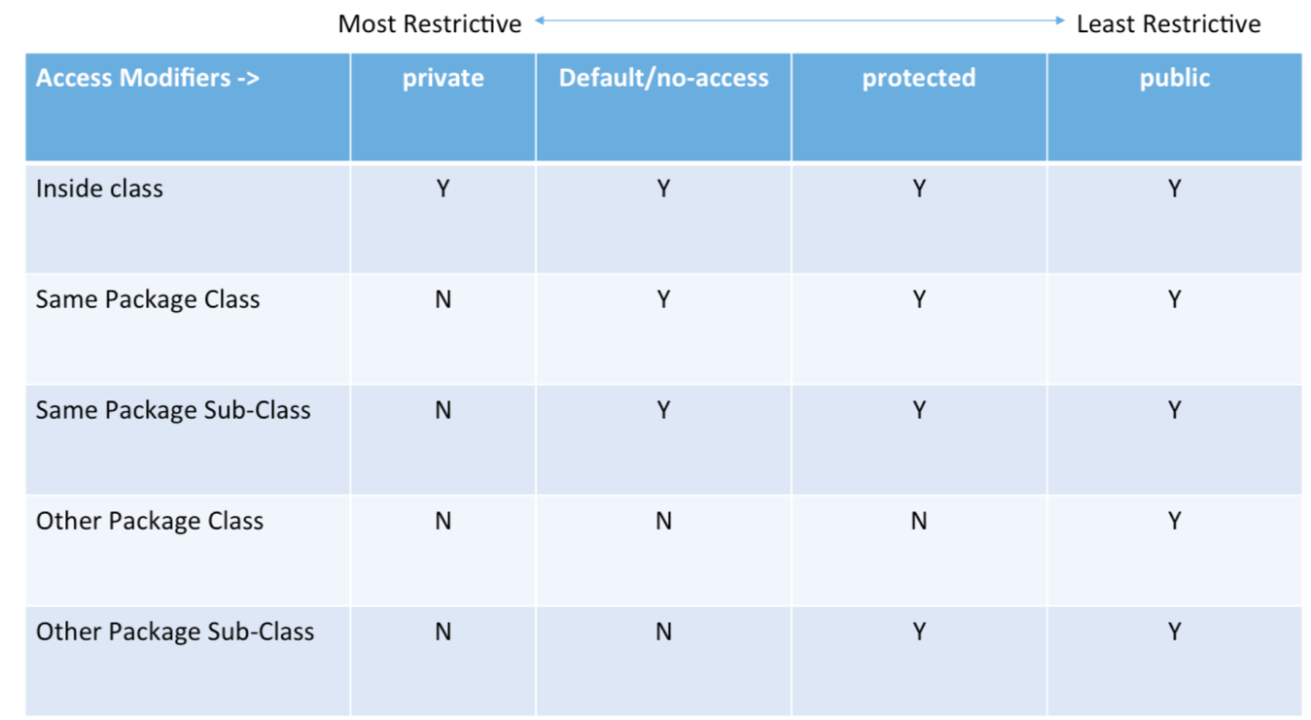
Encapsulation and Visibility

Slide 13
Constructors
Constructors contain operations we want to execute as soon as objects are created (attributes initialization!)
Overloading of constructors is often used
If a constructor is not defined within a class, a default one (with no parameters) is defined. If a constructor is defined, the default one is disabled!
Can be automatically generated in IDEs. In IntelliJ Code -> Generate…
/* Example with two constructors */
public class Car {
public boolean isOn;
public String brand;
public String color;
public Car() {
this.isOn = false;
this.brand = "Fiat";
this.color = "Punto";
}
public Car(boolean isOn, String brand, String color) {
this.isOn = isOn;
this.brand = brand;
this.color = color;
}
. . .
}

Slide 14
Constructors
public class Car {
private String color;
public void setColor(String color) {
this.color = color;
}
}
public class App {
public static void main(String[] args) {
/* Works with default constructor!
Possibly unsafe: attributes not initialized */
Car c = new Car();
}
}

Slide 15
Constructors
public class Car {
private String color;
/* Constructor */
public Car(String color) {
this.color = color;
}
public void setColor(String color) {
this.color = color;
}
}
public class App {
public static void main(String[] args) {
Car c = new Car(); /* Error! Default Constructor missing! */
Car c = new Car(“Red”); /* Works with defined constructor! */
}
}

Slide 16
Constructors
public class Car {
private String color;
public Car() {
this.color = “Red”;
}
public Car(String color) {
this.color = color;
}
public void setColor(String color) {
this.color = color;
}
}
public class App {
public static void main(String[] args) {
Car c = new Car(); /* Works with defined constructor! */
Car c = new Car(“Red”); /* Works with defined constructor! */
}
}

Slide 17
The keyword this
It can be useful in methods to distinguish between instance attributes and local variables (this represents a reference to the current object)
Accessing attributes or methods of the same object do not require using this if there are no ambiguities
class Car{
String color;
...
public Car(String color) {
this.color = color;
}
public setColorRed{
color = Color.RED;
}
}

Slide 18
Overloading and Polymorphism
Methods may have parameters
Inside a Java class, methods with the same name but different overall signatures are allowed
A signature is made by:
Method name
Ordered list of parameters types
The method whose parameters types matches, is selected to be executed
public class Foo {
public int doit(int n, String s) {
return n + s.length();
}
public int doit(String s, int n) {
return n * s.length();
}
public static void main(String[] args) {
Foo f = new Foo();
System.out.println(f.doit(5, "Foo")); // 8
System.out.println(f.doit("Foo", 5)); // 15
}
}

Slide 19
Getters and Setters
Since attributes are usually encapsulated, methods for reading and writing them are useful. These methods are called getters and setters.
It is worth noting that, for reducing the number of errors, using the same name for method parameters and class attributes is a good practice!
Can be automatically generated in IDEs. In IntelliJ Code -> Generate…
class Car {
String color;
...
public String getColor() {
return color;
}
public void setColor(String color) {
this.color = color;
}
}

Slide 20
Getters and Setters
Why use getters and setters/accessors? (Answer #1)
Encapsulation of behaviour associated with getting or setting the property - this allows additional functionality (like validation) to be added more easily later.
Hiding the internal representation of the property while exposing a property using an alternative representation.
Insulating your public interface from change - allowing the public interface to remain constant while the implementation changes without affecting existing consumers.
Controlling the lifetime and memory management (disposal) semantics of the property - particularly important in non-managed memory environments (like C++ or Objective-C).
Providing a debugging interception point for when a property changes at runtime - debugging when and where a property changed to a particular value can be quite difficult without this in some languages.
Improved interoperability with libraries that are designed to operate against property getter/setters - Mocking, Serialization, and WPF come to mind.
Allowing inheritors to change the semantics of how the property behaves and is exposed by overriding the getter/setter methods.
Allowing the getter/setter to be passed around as lambda expressions rather than values.
Getters and setters can allow different access levels - for example the get may be public, but the set could be protected.
https://stackoverflow.com/questions/1568091/why-use-getters-and-setters-accessors

Slide 21
Getters and Setters
Why use getters and setters/accessors? (Answer #2)
Because 2 weeks (months, years) from now when you realize that your setter needs to do more than just set the value, you'll also realize that the property has been used directly in 238 other classes :-)
https://stackoverflow.com/questions/1568091/why-use-getters-and-setters-accessors

Slide 22
toString()
It is handy to obtain a textual representation from objects
In order to provide objects with this feature the method toString() have to be overridden (the default implementation resides in the Object class)
Can be automatically generated in IDEs. In IntelliJ Code -> Generate…
public class Point { int x, y; public Point(int x, int y) { this.x = x; this.y = y; } public static void main(String[] args) {
Point p = new Point(2, 3); System.out.println(p);
System.out.println(System.identityHashCode(p)); } }
# Output
org.nbicocchi.localmods.Point@7344699f
1933863327
public class Point { int x, y; public Point(int x, int y) { this.x = x; this.y = y; } @Override public String toString() { return "Point{" + "x=" + x + ", y=" + y + '}'; } public static void main(String[] args) { System.out.println(new Point(2, 3)); } }
# Output
Point{x=2, y=3}

Slide 23
Static attributes and methods

Slide 24
Static attributes and methods
Static attributes and methods are common to all instances of an object
They exist even when no object has been instantiated!
Widely used for defining traditional functions inside OO software. Classes, in this case, are used just as containers. See Math, Arrays, Collections classes.
Access: ClassName.attributename|methodname
Class Car {
static final int nWheels = 4;
/* … */
}
public static void main(String[] args) {
/* access to static attributes */
int nw = Car.nWheels;
double pi = Math.PI;
}

Slide 25
Static attributes and methods
Static attributes and methods are common to all instances of an object
They exist even when no object has been instantiated!
Widely used for defining traditional functions inside OO software. Classes, in this case, are used just as containers. See Math, Arrays, Collections classes.
Access: ClassName.attributename|methodname
Class Car {
static final int nWheels = 4;
static int getWheels() {
return nWheels;
}
/* … */
}
public static void main(String[] args) {
/* access to static methods */
Car.getWheels();
Double cos = Math.cos();
}

Slide 26
Combining dotted notations
Dotted notations can be combined
System.out.println(“Hello world!”);
System is a class in package java.lang
Out is a (static) attribute of System referencing an object of class PrintStream (representing the standard output)
println() is a method of PrintStream which prints a given string

Slide 27
Wrapper Classes

Slide 28
Wrapper Classes
In an ideal OO environment, only classes and objects should exist
For the sake of performance, Java also uses primitive types (int, float, etc.). Other languages, such as Python, do not support primitive types (everything is an object).
Wrapper classes are objectivized versions of primitive types
Wrapper classes provide several methods for converting to and from primitive types, objectivized versions and Strings, as well as other constants and useful methods.
boolean Boolean
char Character
byte Byte
short Short
int Integer
long Long
float Float
double Double
void Void

Slide 29
Wrapper Classes
In an ideal OO environment, only classes and objects should exist
For the sake of performance, Java also uses primitive types (int, float, etc.). Other languages, such as Python, do not support primitive types (everything is an object).
Wrapper classes are objectivized versions of primitive types
Wrapper classes provide several methods for converting to and from primitive types, objectivized versions and Strings, as well as other constants and useful methods.
class myInteger { int n; public myInteger(int n) { this.n = n; } public int getN() { return n; } public void setN(int n) { this.n = n; } }
// Pay Attention: 10X – 100X slower!

Slide 30
Conversions
autoboxing
obj.toString();
Integer
autounboxing
Integer.valueOf(String);
Integer.toString(int);
String.format()
int
String
Integer.parseInt(String);
Integer.parseInt(String, base);

Slide 31
Auto boxing/unboxing
Auto boxing is the automatic conversion from primitive types and their corresponding wrapper classes. The plain variable is boxed into an object. For example, converting an int to an Integer, a double to a Double, and so on.
Auto unboxing, on the contrary, is the automatic conversion from wrapper classes to their corresponding primitive types.
public class AutoboxingExample {
public static Integer method(Integer n) { System.out.println(n); return n; }
public static void main(String[] args) { int i = 2 + method(2); } }

Slide 32
Package

Slide 33
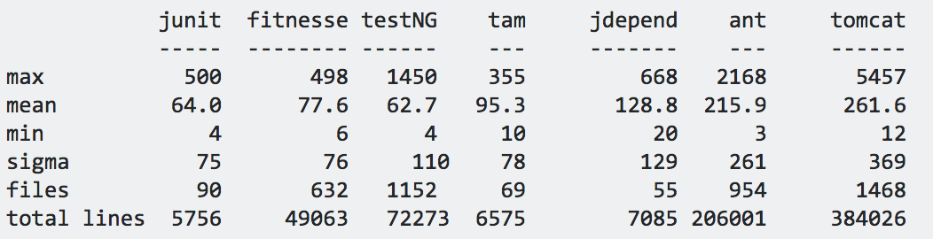
Motivation
Classes are better at modularizing code than functions.
However, classes are little (50-250 lines of code, on average)
For the sake of additional modularization, packages are used
A package is a set of class definitions all stored within the same directory
Visibility rules apply to packages
The public interface of a package is the public portion of the classes contained in the package
Minimize the number of classes, attributes, methods (of the package) visible from the outside

Slide 34
Definition and usage
package packageName;
Package statement (first line of class file)
import packageName.className;
Import statements (after package statement)
If two packages contain a class with the same name, they cannot be both imported. If you need both classes you have to use one of them with its fully-qualified name:
import java.sql.Date; Date d1 = new Date(); // java.sql.Date java.util.Date d2 = new java.util.Date();
package oop.localmods; import java.awt.Point; public class Test { public static Point allocatePoint(int x, int y) { return new Point(x, y); } public static void main(String[] args) { Point p = allocatePoint(2, 3); System.out.println(p); } }

Slide 35
Package
A package is identified by a name with a hierarchic structure (fully qualified name)
java.lang
java.util
java.sql
Conventions for defining unique names is based on Internet naming but in reverse order (from general to specific concepts)
org.oop.basics
It’s possible to use same class names in different packages without conflicts
java.util.Date
java.sql.Date

Slide 36
Inheritance

Slide 37

Motivation
They all move, have a shape, shields, and weapons. Can they share the same code?

Slide 38
Motivation
Frequently, a class is merely a modification of another class. Inheritance allows minimal repetition of the same code
A new design created by changing an existing design. (The new design consists of only the changes)
Localization of code
Fixing a bug in the base class automatically fixes it in the subclasses
Adding functionalities to the base class automatically adds them to the subclasses
Reduced chances of different (and inconsistent) implementations of the same operation

Slide 39
Inheritance
A class can be a sub-type of another class
The inheriting class contains all the attributes and methods of the class it inherited from
The inheriting class can define additional attributes and methods
The inheriting class can override the definition of existing methods by providing its own implementation
The code of the inheriting class consists only of the changes and additions to the base class

Slide 40
Example I (extension)
Class Car {
boolean isOn;
String licensePlate;
void turnOn() {…}
void turnOff() {…}
}
Class SDCar extends Car {
boolean isSelfDriving;
void turnSDOn() {…}
void turnSDOff() {…}
}
SDCar c = new SDCar();
c.turnOn(); // OK!
c.turnSDOn(); // OK!
*SD = Self Driving

Slide 41
Example II (override)
Class Car {
boolean isOn;
String licensePlate;
void turnOn() {…}
void turnOff() {…}
}
Class SDCar extends Car {
boolean isSelfDriving;
/* method override */
void turnOn() {
turnSDOff();
/* … */
}
/* method override */
void turnOff() {
turnSDOff();
/* … */
}
void turnSDOn() {…}
void turnSDOff() {…}
}

Slide 42
Example III (override)
Class Car {
boolean isOn;
String licensePlate;
void turnOn() {…}
void turnOff() {…}
}
Class SDCar extends Car {
boolean isSelfDriving;
/* override */
void turnOn() {
turnSDOff();
super.turnOn();
}
void turnOff() {
turnSDOff();
super.turnOff();
}
void turnSDOn() {…}
void turnSDOff() {…}
}

Slide 43
Class SDCar
Inherits
attributes (isOn, licencePlate)
methods (turnOn, turnOff)
Adds
attributes (isSelfDriving)
methods (turnSDOn, turnSDOff)
Modifies (overrides)
methods (turnOn, turnOff)
Class SDCar extends Car {
boolean isSelfDriving;
/* override */
void turnOn() {
turnSDOff();
super.turnOn();
}
void turnOff() {
turnSDOff();
super.turnOff();
}
void turnSDOn() {…}
void turnSDOff() {…}
}

Slide 44
this and super
this is a reference to the current object
super is a reference to the parent class

Slide 45
Terminology
Class one above
Parent class
Class one below
Child class
Class one or more above
Superclass, Ancestor class, Base class
Class one or more below
Subclass, Descendent class

Slide 46
Visibility and Inheritance

Slide 47
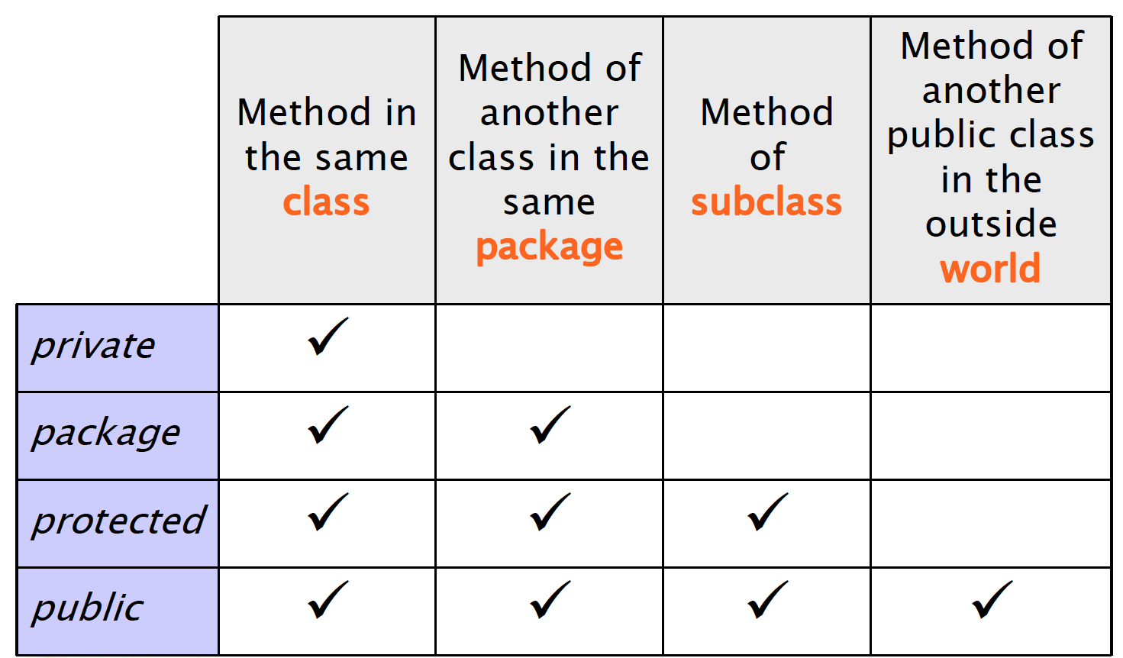
Recap

Slide 48
Visibility
Class Car {
private boolean isOn;
private string licensePlate;
public void turnOn() {…}
public void turnOff() {…}
}
Class SDCar extends Car {
void print() {
/* Do not work! Not visible! */
System.out.println(licencePlate);
}
}

Slide 49
Visibility
Class Car {
boolean isOn;
string licensePlate;
public void turnOn() {…}
public void turnOff() {…}
}
Class SDCar extends Car {
void print() {
/*
* Works if Car and SDCar
* share the same package
*/
System.out.println(licencePlate);
}
}

Slide 50
Visibility
Class Car {
protected boolean isOn;
protected string licensePlate;
public void turnOn() {…}
public void turnOff() {…}
}
Class SDCar extends Car {
void print() {
/* Works anyway! */
System.out.println(licencePlate);
}
}

Slide 51
Inheritance and Constructors

Slide 52
Construction of child objects
Since each subclass “contains” an instance of the parent class, the latter must be initialized
Java compiler automatically calls the default constructor (no params!) of the parent class
The call is inserted as the first statement of each child constructor. If parent class disabled default constructor (by defining others) parent constructor must be called explicitly!

Slide 53
super()
this is a reference to the current object
super is a reference to the parent class
super() calls the default constructor of parent class
super(params) calls other constructors of parent class
Must be the first statement in child constructors

Slide 54
Construction of child objects
class Car {
boolean isOn;
String licensePlate;
/* Default constructor enabled! */
}
class SDCar extends Car {
boolean isSelfDriving;
/* Default constructor enabled! */
} // Works!

Slide 55
Construction of child objects
class Car {
boolean isOn;
String licensePlate;
/* Default constructor enabled! */
}
class SDCar extends Car {
boolean isSelfDriving;
/* Default constructor disabled! */
public SDCar() {
/* automatic call to parent default constructor here! */
}
} // Works!

Slide 56
Construction of child objects
class Car {
boolean isOn;
String licensePlate;
/* Default constructor disabled! */
public Car(boolean isOn, String licensePlate) {
this.isOn = isOn;
this.licencePlate = licensePlate;
}
}
class SDCar extends Car {
boolean isSelfDriving;
/* Default constructor disabled! */
public SDCar() {
/* automatic call to parent default constructor here! */
}
} // Not working!

Slide 57
Construction of child objects
class Car {
boolean isOn;
String licensePlate;
/* Default constructor disabled! */
public Car(boolean isOn, String licensePlate) {
this.isOn = isOn;
this.licencePlate = licensePlate;
}
}
class SDCar extends Car {
boolean isSelfDriving;
/* Default constructor disabled! */
public SDCar(boolean isOn, String licensePlate, boolean isSelfDriving) {
super(isOn, licencePlate);
this.isSelfDriving = isSelfDriving;
}
} // Works!

Slide 58
Construction of child objects
Execution of constructors proceeds top-down along the inheritance hierarchy
In this way, when a method of the child class is executed (constructor included), the super-class is completely initialized already
class Car{
Car() {
super();
System.out.println(“Car”);
}
}
class SDCar extends Car {
SDCar() {
super();
System.out.println(“SDCar”);
}
}
// Which output?
SDCar c = new SDCar();

Slide 59
Overriding and Polymorphism
When using collections of objects belonging to a hierarchy of classes, methods actually called are known only at runtime.
The same call (methods with the same signature) might have different results (polymorphism) depending on the actual class of the object.
* https://en.wikipedia.org/wiki/Late_binding
Car[] garage = new Car[4];
garage[0] = new Car();
garage[1] = new SDCar();
garage[2] = new SDCar();
garage[3] = new Car();
for(Car c : garage) {
c.turnOn();
}
/*
Which method is actually called
is not knowable at compile time!
*/

Slide 60
Java.lang.Object

Slide 61
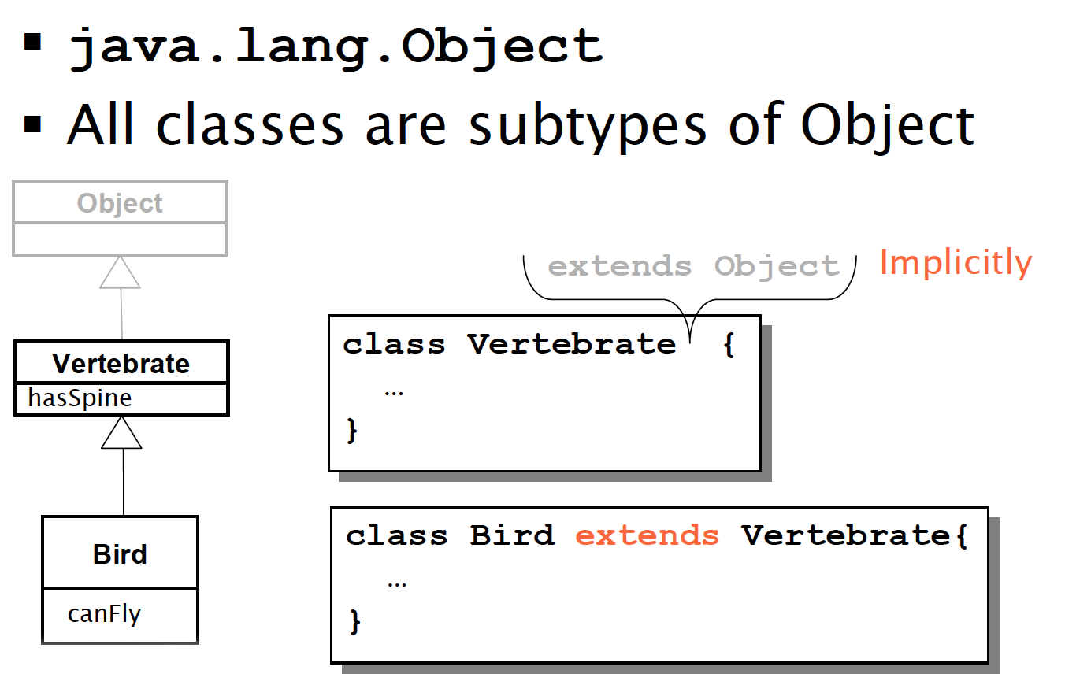
Java.lang.Object

Slide 62
Java.lang.Object
All objects can be seen as Object instances
Object defines basic services, which are useful for all classes. They are often overridden in sub-classes. For example:
toString(): returns a string representation
equals(Object o): tests equality
clone(): returns a shallow copy of the object

Slide 63
toString()
class Car{
String licencePlate;
public String toString(){
return “[Car] ” + licencePlate;
}
}
Car c = new Car();
// println(Object) call
System.out.println(c);
// println(String) call
System.out.println(c.toString());

Slide 64
equals(Object o)
public class Car {
boolean isOn;
String licencePlate;
public Car(boolean isOn, String licencePlate) {
this.isOn = isOn;
this.licencePlate = licencePlate;
}
public static void main(String[] args) {
Car c1 = new Car(true, "AA334GG");
Car c2 = new Car(true, "AA334GG");
System.out.println(c1.equals(c2)); // false!
}
}

Slide 65
equals(Object o)
public class Car {
boolean isOn;
String licencePlate;
public Car(boolean isOn, String licencePlate) {
this.isOn = isOn;
this.licencePlate = licencePlate;
}
/* the equals() methods must be overridden */
public boolean equals(Object obj) {
Car other = (Car) obj;
if (isOn != other.isOn)
return false;
if (licencePlate != other.licencePlate)
return false;
return true;
}
}

Slide 66
Casting

Slide 67
Types
Java is a strictly typed language. Each variable has a type!
float f;
f = 4.7; //OK!
f = “hello!”; //!OK
Car c;
c = new Car(); //OK!
c = new String(); //!OK

Slide 68
Upcasting and Downcasting
class Car {};
class SDCar extends Car {};
Car c1 = new Car(); // OK!
SDcar c2 = new SDCar (); // OK!
But also…
Car c3 = new SDcar();

Slide 69
Upcasting and Downcasting
Car c3 = new SDcar();
Specialization defines a sub-typing relationship (is a ).
All SDCar(s) are Car(s). Not all Car(s) are SDCar(s).
Upcasting and downcasting refer to the possibility of changing the reference type of a given object. Upcasting consists in using more general references, while downcasting more specific references.
Upcast
Downcast
SDCar(s)
Car(s)

Slide 70
Upcasting and Downcasting
More general
Reference (Car)
More specific
Reference (SDCar)
Actual object methods (SDCar)

Slide 71
Upcasting
class Car {};
class SDCar extends Car {};
Car c = new SDCar();
Assignment from a more specific type to a more general type
Note well: reference type and object type are separate concepts. Object referenced by ‘c’ continues to be of SDCar type! Only the interface changes!

Slide 72
Upcasting
It is dependable
It is always true that an SDCar is a Car too
It is automatic
Car c = new SDCar();

Slide 73
Example
Class Car {
boolean isOn;
string licensePlate;
void turnOn() {…}
void turnOff() {…}
}
Class SDCar extends Car {
boolean isSelfDriving;
void turnSDOn() {…}
void turnSDOff() {…}
}
SDCar c1 = new SDCar();
c1.turnSDOn() // OK!
Car c2 = c1; // Upcast
c2.turnSDOn() // Compile time error!
(Car interface does not provide turnSDOn() call)

Slide 74
Downcasting
Assignment from a more general type (super-type) to a more specific type (sub-type)
Reference type and object type do not change
MUST be explicit
It’s a risky operation, no automatic conversion provided by the compiler (it’s up to you!)

Slide 75
Example
Class Car {
boolean isOn;
string licensePlate;
void turnOn() {…}
void turnOff() {…}
}
Class SDCar extends Car {
boolean isSelfDriving;
void turnSDOn() {…}
void turnSDOff() {…}
}
Car c1 = new SDCar();
c1.turnSDOn() // Compile time error!
SDCar c2 = (SDcar)c1; // Downcast
c2.turnSDOn() // Accidentally OK! The object referenced by c1 was actually of class SDCar

Slide 76
Example
Class Car {
boolean isOn;
string licensePlate;
void turnOn() {…}
void turnOff() {…}
}
Class SDCar extends Car {
boolean isSelfDriving;
void turnSDOn() {…}
void turnSDOff() {…}
}
Car c1 = new Car();
c1.turnSDOn() // Compile time error!
SDCar c2 = (SDcar)c1; // Downcast
c2.turnSDOn() // Run time error!

Slide 77
Runtime is evil
Compilers aid developers in writing working code. Runtime errors cannot be identified by compilers. Developers must be careful!
Use the instanceof operator
Car c = new SDCar();
if (c instanceof SDCar){
SDCar sdc = (SDCar) c;
sdc.turnSDOn();
}

Slide 78
Upcast to object
Each class is either directly or indirectly a subclass of Object
It is always possible to upcast any instance to Object type (see Collection)
AnyClass any = new AnyClass();
Object obj = (Object)any;

Slide 79
Abstract Classes and Interfaces

Slide 80
Abstract methods
You can declare an object without implementing it:
Person p;
Similarly, you can declare a method without implementing it (i.e., the body of the method is missing):
public abstract void draw(int size);
A method that has been declared but not defined is an abstract method
80

Slide 81
Abstract classes
Any class containing one or more abstract methods is an abstract class
An abstract class is incomplete in the sense it has missing method bodies
You must declare the class with the keyword abstract:
abstract class MyClass {...}
You cannot instantiate (create a new instance of) an abstract class

Slide 82
Abstract classes
You can extend (subclass) an abstract class
If the subclass defines all the inherited abstract methods, it is concrete and can be instantiated
If the subclass does not define all the inherited abstract methods, it must be abstract too
You can declare a class to be abstract even if it does not contain any abstract methods
This just prevents the class from being instantiated

Slide 83
Why use abstract classes?
Suppose you wanted to create a class Shape, with subclasses Oval, Rectangle, Triangle, Hexagon, etc.
Each subclass has a method draw() for representing its shape on a 2D graphic panel

Slide 84
A problem
class Shape { ... }
class Star extends Shape { void draw() { ... } ... }
class Circle extends Shape { void draw() { ... } ... }
Shape s;
s = new Shape(); // Legal, but unwanted
s.draw(); // Illegal, Shape does not have draw()
s = new Star(); // Legal, because a Star is a Shape
s.draw(); // Illegal, Shape does not have draw()

Slide 85
Same problem, another view
Shape[] shapes = new Shape[16];
shapes[0] = new Circle();
shapes[1] = new Star();
…
for (Shape s : shapes) {
s.draw(); // Illegal, Shape does not have draw()
}

Slide 86
A solution
abstract class Shape { abstract void draw(); }
class Star extends Shape { void draw() { ... } ... }
class Circle extends Shape { void draw() { ... } ... }
Shape s;
s = new Shape(); // Illegal, Shape is abstract
s = new Star(); // Legal, because a Star is a Shape
s.draw(); // Legal, Shape does have draw()

Slide 87
Another problem
Let’s suppose that all shapes must have two capabilities:
Drawing their own shape [draw() method]
Setting a unique ID [setID() method]
87

Slide 88
A solution
We can keep the Shape class abstract while providing a common implementation of the setID() method.
Benefits
Shape cannot be instantiated
Shape subclasses can redefine draw()
Drawbacks
We partially loose the possibility to define abstract concepts such as Shape. Now Shape contains code!
abstract class Shape {
void setID() { . . . }; abstract void draw(); }
class Star extends Shape { void draw() { ... } ... }
class Circle extends Shape { void draw() { ... } ... }
88

Slide 89
A better solution
We can use a Shape Interface.
Interfaces are special classes for declaring methods without supplying implementations
All their methods are implicitly public and abstract
Interfaces cannot be instantiated because they do not contain actual code
When a class implements an interface, it promises to define all the methods declared in the interface
interface Shape() {
public abstract void setID(); public abstract void draw();
}
abstract class AbstractShape implements Shape {
void setID() { . . . }; abstract void draw(); }
class Star extends AbstractShape { void draw() { ... } ... }
class Circle extends AbstractShape { void draw() { ... } ... }
Level of abstraction
89

Slide 90
Specialization and partial implementation
Interfaces can be specialized
Specializing an interface means adding new methods in derived interfaces. Overriding methods does not make sense in interfaces because code is absent.
Interfaces can be partially implemented
Partial implementations of interfaces can be found in abstract classes. The unimplemented methods must be marked as abstract.

Slide 91
Multiple inheritance
In Java, a class can only extend one class, but can implement multiple interfaces
This lets the class fill multiple roles (i.e., multiple set of methods)
In graphical interfaces (GUIs), it is common to have one class implementing several listeners (i.e., interfaces)
class Application extends JFrame implements ActionListener, KeyListener { ... }

Slide 92
Multiple inheritance
public class GroudVehicle {
activateWheels() {…}
…
}
public class WaterVehicle {
activateWaterFans() {…}
…
}
// Not allowed in Java!! Only one class can be extended!
public class Anphibian extends GroudVehicle, WaterVehicle {
…
}
92

Slide 93
Multiple inheritance
public interface GroudVehicle {
activateWheels();
…
}
public interface WaterVehicle {
activateWaterFans();
…
}
public class Anphibian implements GroudVehicle, WaterVehicle {
activateWheels() {…}
activateWaterFans() {…}
…
}
93

Slide 94
Interfaces and instanceof
instanceof is a keyword that tells you whether a variable “is a” member of a class or interface
Membership of a class or interfaces can be translated with “has its methods implemented”
class Dog extends Animal implements Pet {...}
Dog lessie = new Dog();
lessie instanceof Dog //OK!
lessie instanceof Animal //OK!
lessie instanceof Pet //OK!

Slide 95
Modelling Object Oriented Software

Slide 96
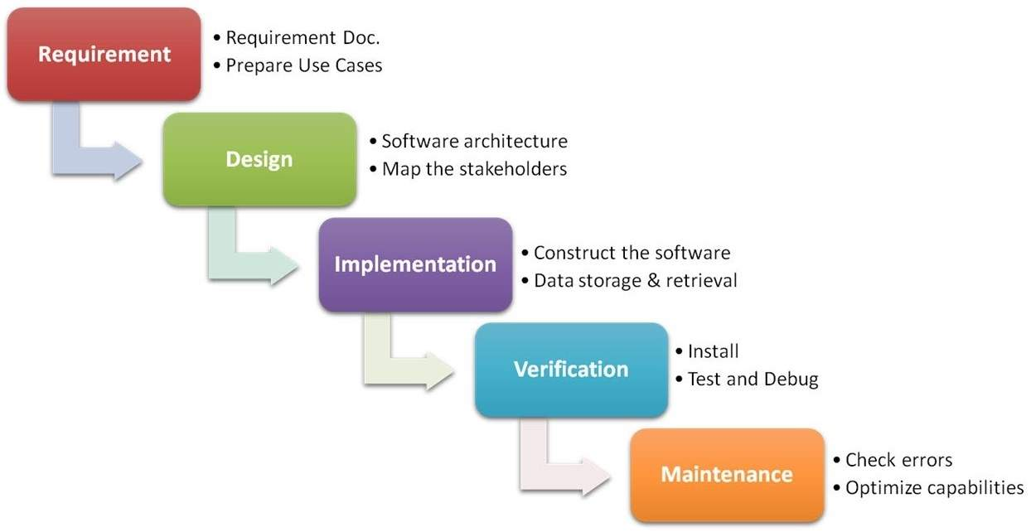
Waterfall model

Slide 97
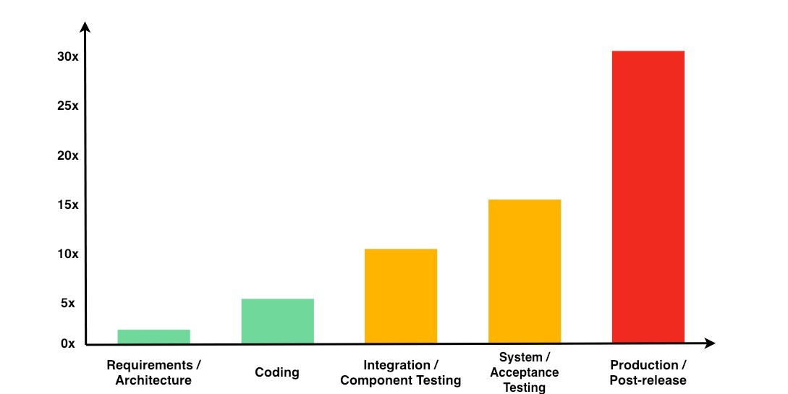
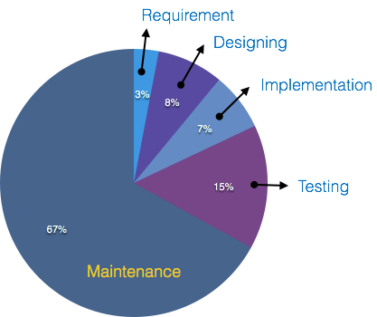
Software life-cycle costs

Slide 98
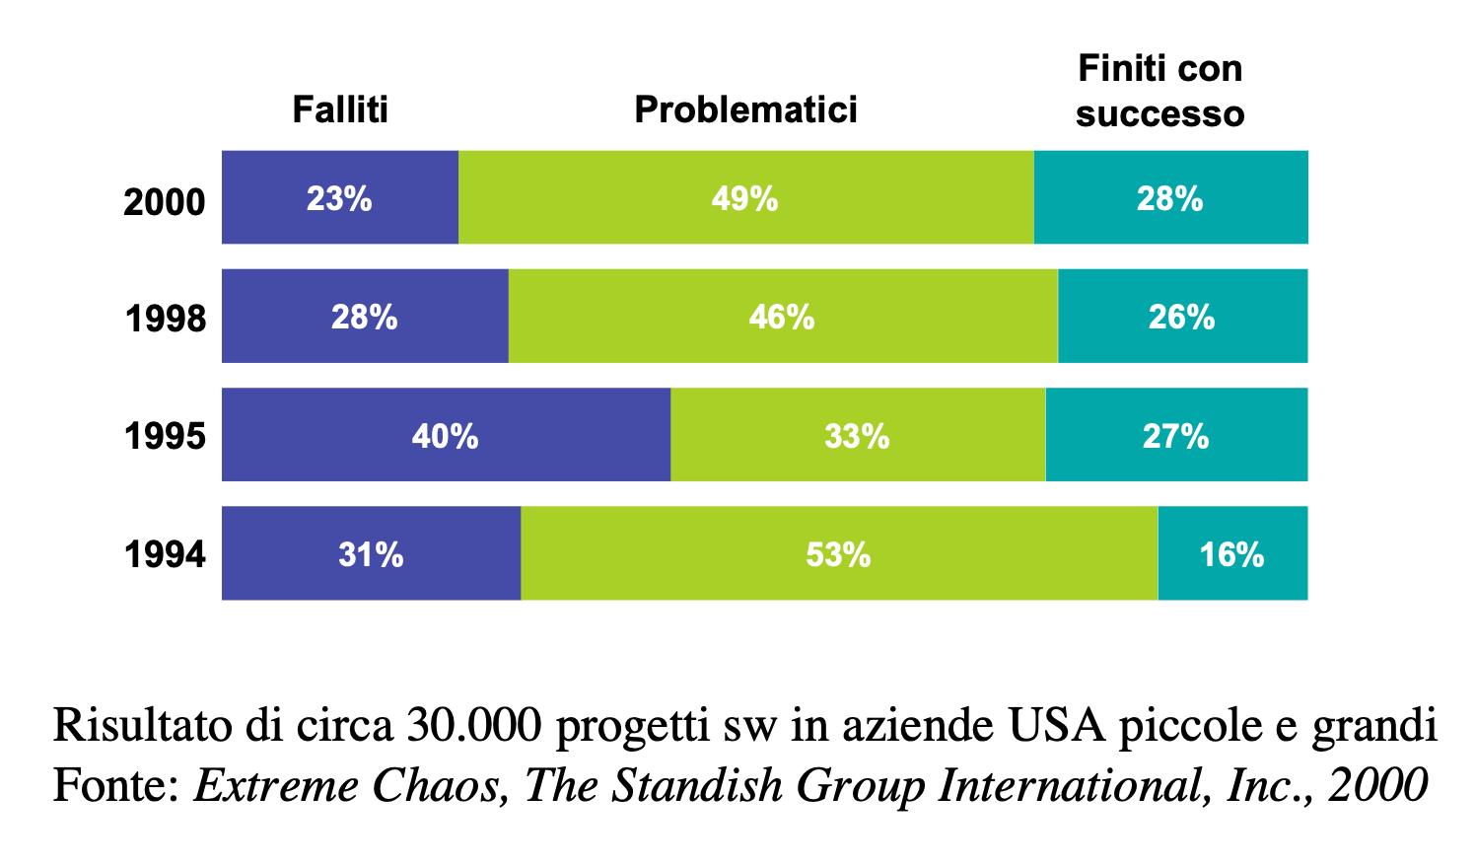
Failure rates of software projects

Slide 99
Root causes of failures
Lack of user participation
Changing requirements
Badly defined system requirements
Unrealistic or unarticulated project goals
Lack of Stakeholder involvement
Unmanaged risks
Poor communication among customers, developers, and users
Use of immature technology
Inability to handle the project’s complexity
Sloppy development practices
Poor project management
Poor reporting of the project’s status
Inaccurate estimates of needed resources
Commercial pressures

Slide 100
So what?
Iterative development models
RUP, SCRUM, Extreme Programming
Modelling tools and languages
UML

Slide 101
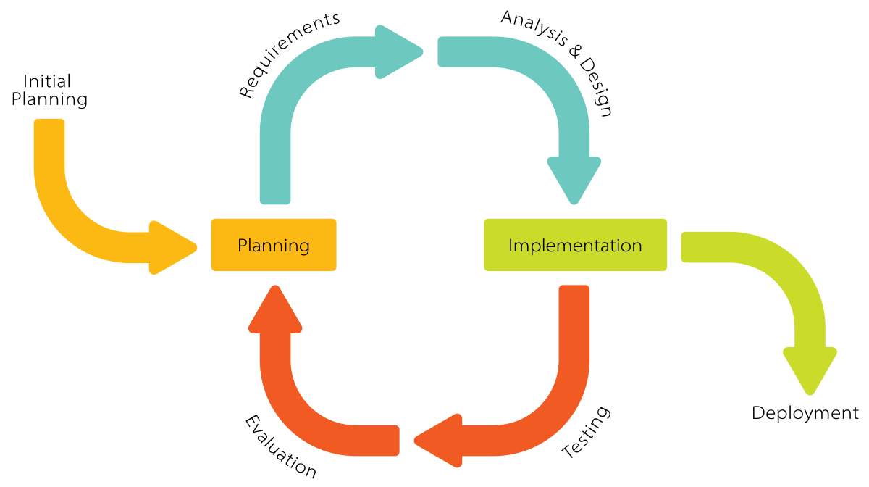
Iterative development models

Slide 102
Modelling tools and languages
UML stands for Unified Modeling Language
Language: express idea, not a methodology
Modeling: Describing a software system at a high level of abstraction
Unified: UML has become a world standard

Slide 103
UML
It is a industry-standard graphical language for specifying, visualizing, constructing, and documenting the artifacts of software systems
UML uses mostly graphical notations to express the OO analysis and design of software projects.
Simplifies the complex process of software design

Slide 104
UML benefits
Use graphical notation: more clearly than natural language (imprecise) and code (too detailed).
Help acquire an overall view of a system.
UML is not dependent on any one language or technology.
UML moves us from fragmentation to standardization.

Slide 105
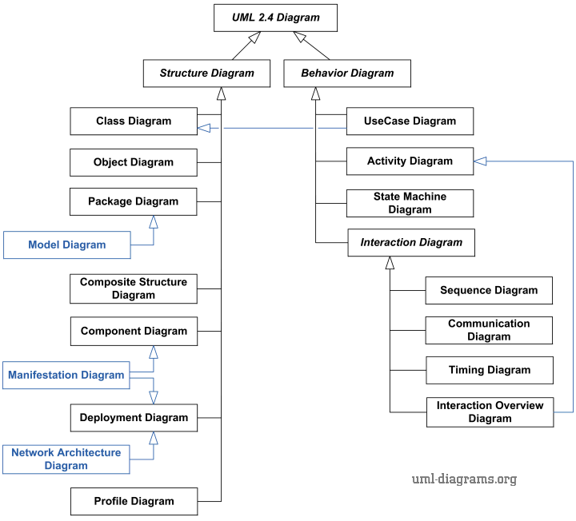
UML diagrams

Slide 106
Class diagram
A class diagram depicts classes and their interrelationships
Used for describing the internal structure of a software system
Provide a conceptual model of the system in terms of entities and their relationships
Detailed class diagrams are used for developers

Slide 107
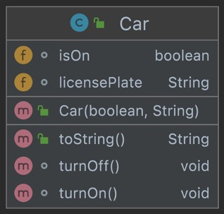
Class
package org.nbicocchi.oopinheritance.car;
public class Car {
boolean isOn;
String licensePlate;
public Car(boolean isOn, String licensePlate) {
this.isOn = isOn;
this.licensePlate = licensePlate;
}
void turnOn() {
isOn = true;
}
void turnOff() {
isOn = false;
}
@Override
public String toString() { … }
}

Slide 108
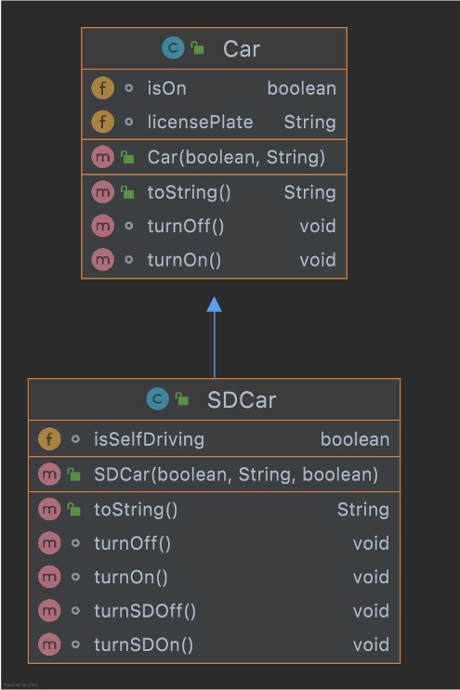
Hierachy
public class SDCar extends Car {
boolean isSelfDriving;
public SDCar(boolean isOn, String licensePlate, boolean isSelfDriving) {
super(isOn, licensePlate);
this.isSelfDriving = isSelfDriving;
}
@Override
void turnOn() {
isSelfDriving = false;
super.turnOn();
}
@Override
void turnOff() {
isSelfDriving = false;
super.turnOff();
}
void turnSDOn() {
isSelfDriving = true;
}
void turnSDOff() {
isSelfDriving = false;
}
@Override
public String toString() {…}
}

Slide 109
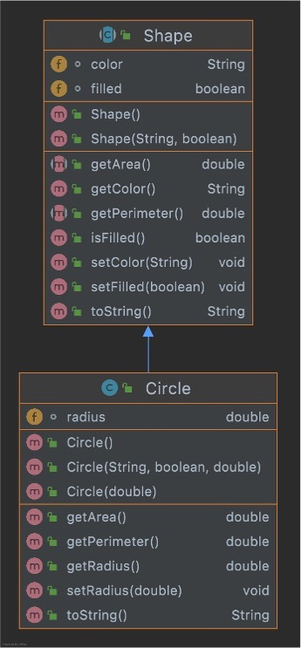
Abstract class
public abstract class Shape {
String color;
boolean filled;
public Shape() {
this.color = "Black";
this.filled = false;
}
public Shape(String color, boolean filled) {
this.color = color;
this.filled = filled;
}
. . .
public abstract double getArea();
public abstract double getPerimeter();
}

Slide 110
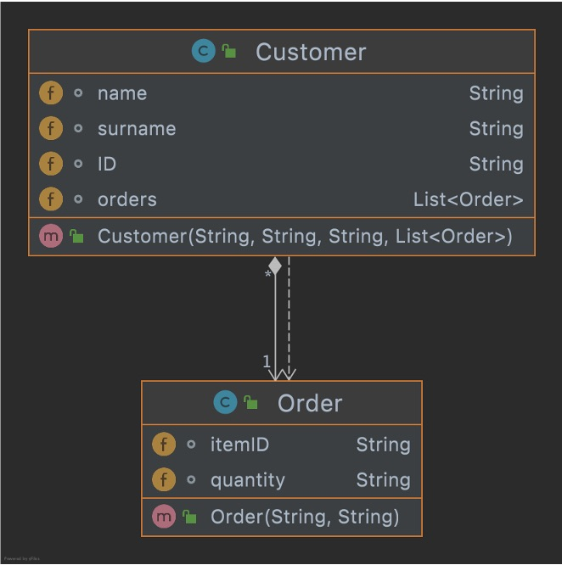
Association
public class Customer {
String name;
String surname;
String ID;
List<Order> orders;
public Customer(String name, String surname, String ID, List<Order> orders) {
this.name = name;
this.surname = surname;
this.ID = ID;
this.orders = orders;
}
}
public class Order {
String itemID;
String quantity;
public Order(String itemID, String quantity) {
this.itemID = itemID;
this.quantity = quantity;
}
}

Slide 111
Association
public class Customer {
String name;
String surname;
String ID;
public Customer(String name, String surname, String ID) {
this.name = name;
this.surname = surname;
this.ID = ID;
}
}
public class Order {
String itemID;
String quantity;
Customer customer;
public Order(String itemID, String quantity, Customer customer) {
this.itemID = itemID;
this.quantity = quantity;
this.customer = customer;
}
}

Slide 112
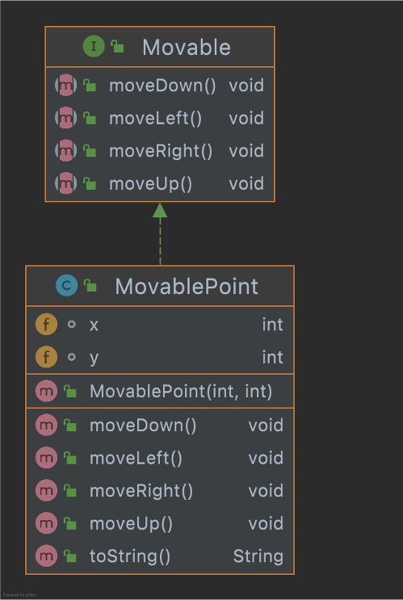
Interface
public interface Movable { void moveUp(); void moveDown(); void moveLeft(); void moveRight(); }
public class MovablePoint implements Movable {
int x;
int y;
public MovablePoint(int x, int y) {
this.x = x;
this.y = y;
}
@Override
public void moveUp() {
y += 1;
}
@Override
public void moveDown() {
y -= 1;
}
@Override
public void moveLeft() {
x -= 1;
}
@Override
public void moveRight() {
x += 1;
}
}

Slide 113
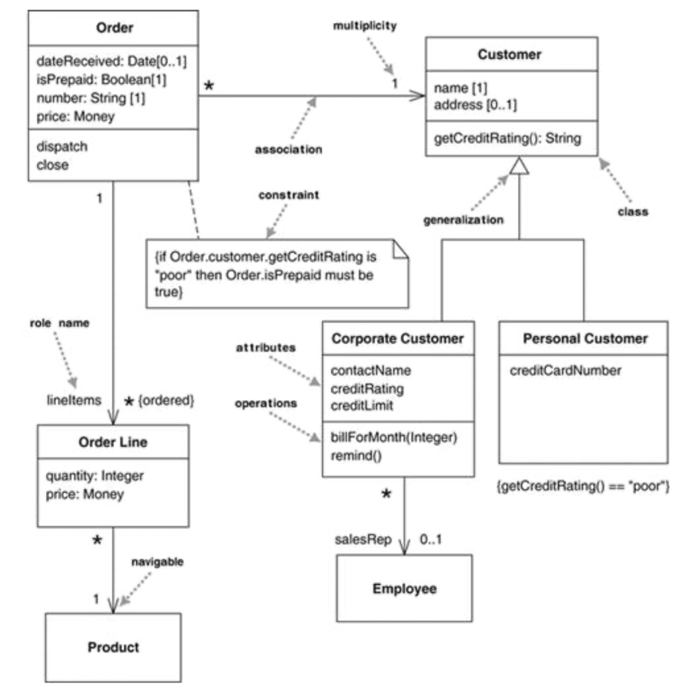
A complete example

Slide 114
Wisdom Pills
Complexity has nothing to do with intelligence, simplicity does.
— Larry Bossidy
Perfection is achieved, not when there is nothing more to add, but when there is nothing left to take away.
— Antoine de Saint Exupery

